Slide 1
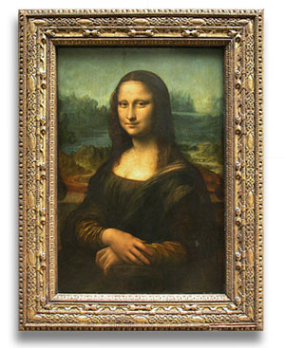
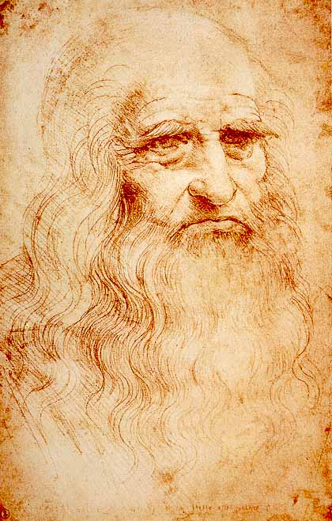
Leonardo Da Vinci’s
Mona Lisa

Slide 2
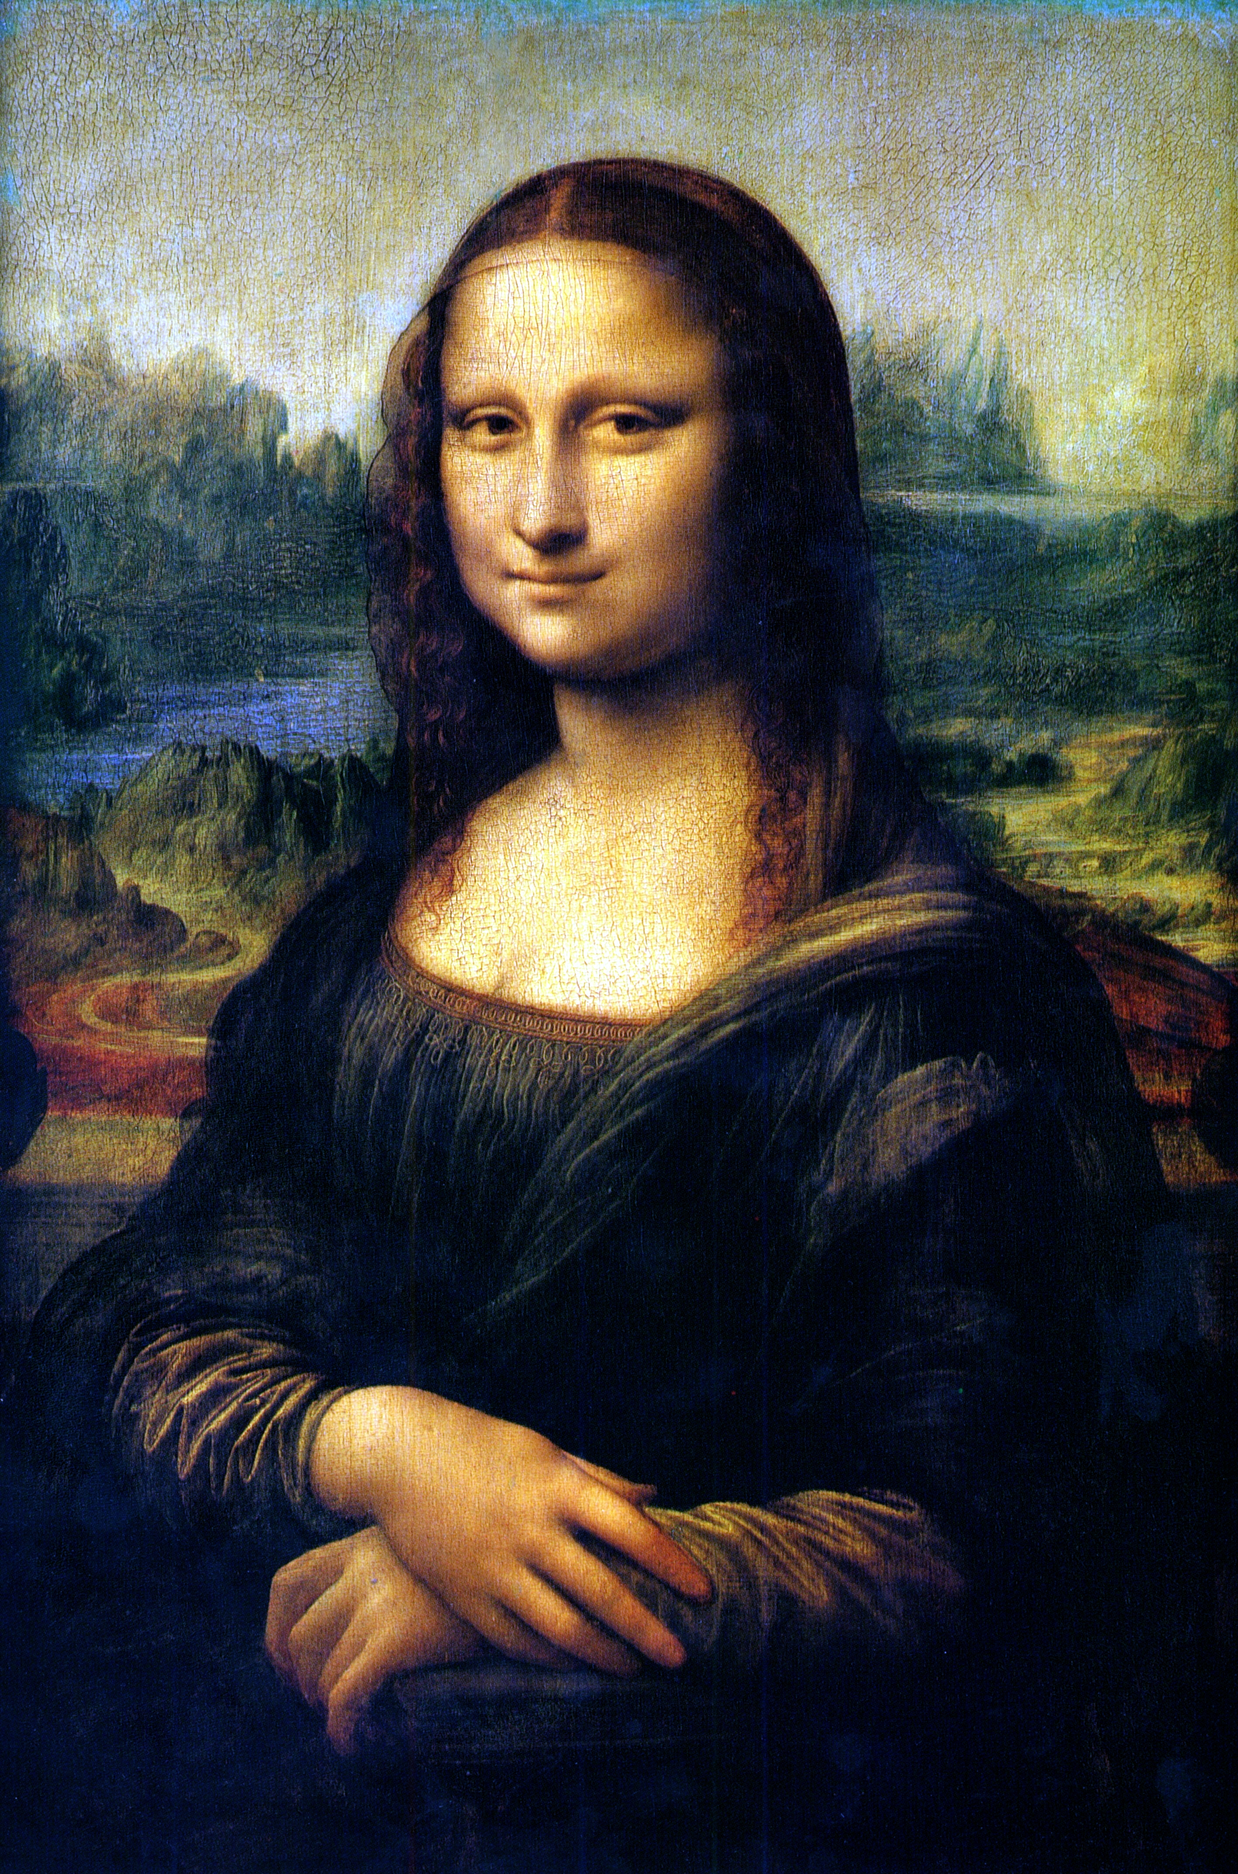
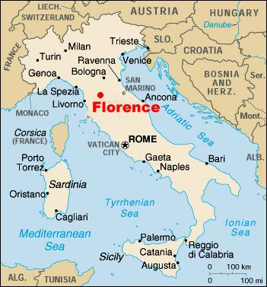
Mona Lisa: The Facts
Painted in Florence, Italy
1503-1506
Oil paint on wood, approximately 30x21”
Thought to be a portrait of Lisa Gherardini, the wife of the merchant, Francesco del Giocondo.

Slide 3
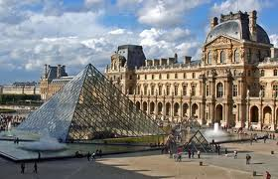
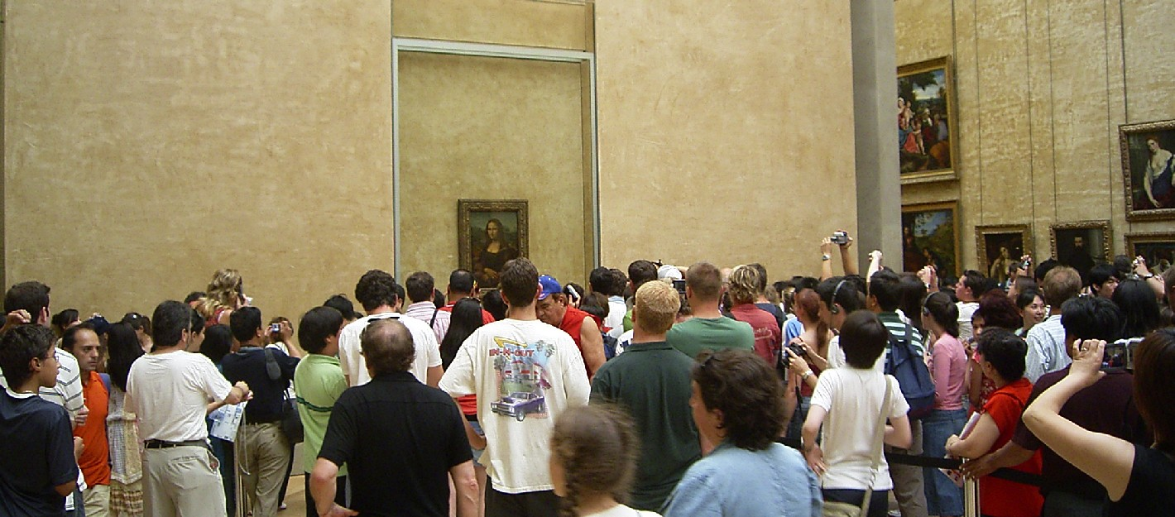
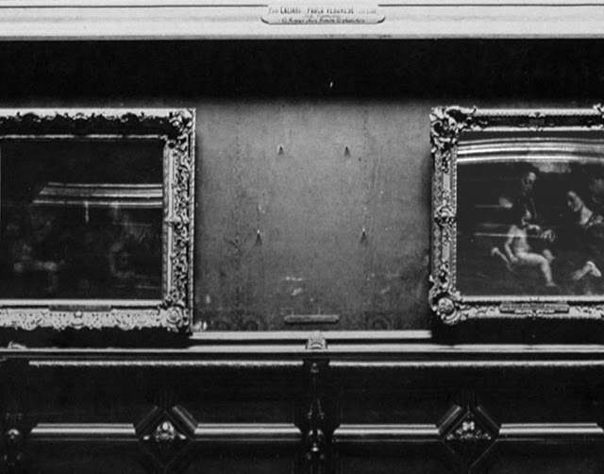
Mona Lisa: Where is she?
On display at the Louvre since 1787…227 years!
Stolen in 1911, returned in 1913- this theft helped make her famous.
What’s so special about a portrait?

Slide 4
Mona Lisa: Let’s talk.
Describe- What colors, lines, shapes, textures do you see? What’s in the foreground, middleground, background? (1 min.)
Analyze- What is most important part of this artwork? Why do you think so? (3 mins.)
Interpret- What is Mona Lisa thinking? Why do you think so? What is DaVinci trying to communicate? Why do you think so? (3 mins.)

Slide 5
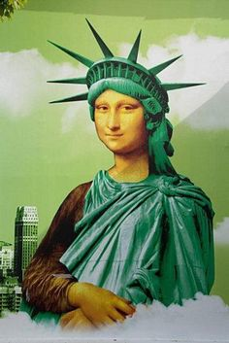
Mona Lisa: What’s a parody?
A parody is funny imitation of a person, artwork, music, writing, event.
Artists borrow ideas from each other to create something new.

Slide 6
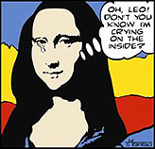
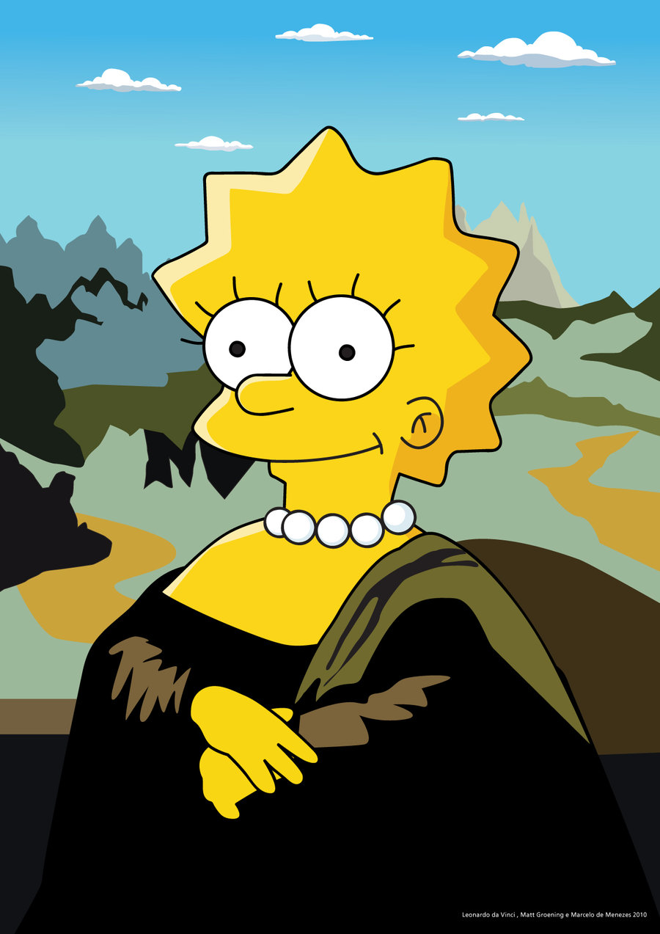
Mona Lisa: Most Parodied Artwork
How do these parodies show humor?

Slide 7
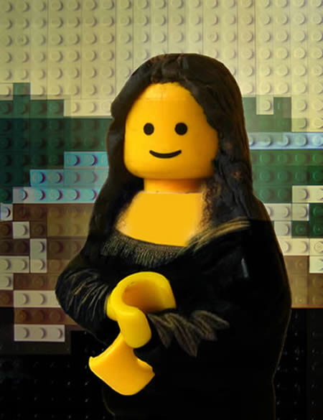
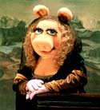
Mona Lisa: Most Parodied Artwork
How are these two parodies similar to the real Mona Lisa?

Slide 8
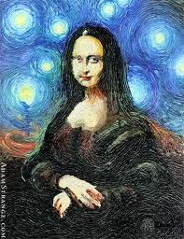
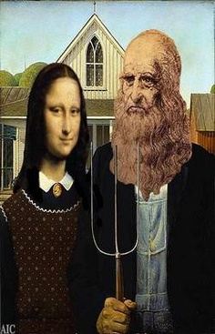
Mona Lisa: Most Parodied Artwork
How would other famous artists interpret the Mona Lisa?

Slide 9
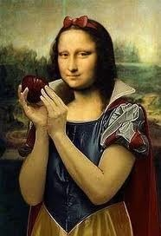
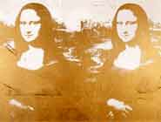
Mona Lisa: Most Parodied Artwork
Andy Warhol
Why would Warhol make two connected prints of the Mona Lisa?

Slide 10
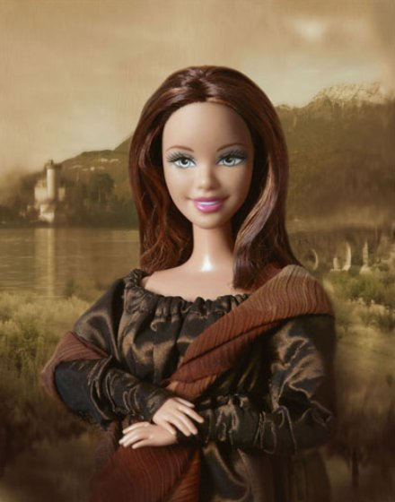
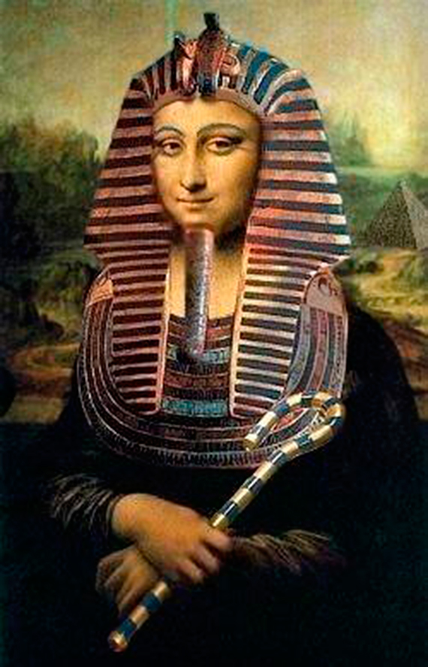
Mona Lisa: Most Parodied Artwork
How could the Barbie Mona Lisa be made more Barbie-like?

Slide 11
Mona Lisa Parody: Goals
Fully explore Mona Lisa’s new character: person, clothing, background
At least 2 types of media. Media should enhance your parody.
Think: How is your parody similar to and different from the original Mona Lisa?
Think: How would a viewer describe, analyze, & interpret your parody?

Slide 12
Mona Lisa Rubric
Categories | Level 1 10 pts | Level 15 pts | Level 3 20 pts | Level 4 25 pts
Parody- character | Level 1 The artwork does not explore the new character of the Mona Lisa. The artwork does not show a parody of the Mona Lisa. | Level 2 The artwork partially explores the new character of the Mona Lisa. The parody includes few changes to person, clothes, background. The artwork somewhat parodies the Mona Lisa. | Level 3 The artwork mostly explores the new character of the Mona Lisa, including some changes to person, clothes, background. The artwork clearly parodies the Mona Lisa. | Level 4 The artwork fully explores the new character of the Mona Lisa, including changes to all three: person, clothes, background. The artwork clearly and creatively parodies the Mona Lisa.
Use of Media | Level 1 The student only used one form of 2-D media. | Level 2 The student used two forms of 2-D media. The media doesn't enhance the parody character. | Level 3 The student used two forms of 2-D media. The media mostly enhances the parody character. | Level 4 The student creatively used two or more forms of 2-D media. The media was carefully chosen to enhance the parody character.
Effort | Level 1 The student did not complete the project. The student had little focus and needed many reminders to focus. | Level 2 The student completed the project, but didn't focus. The student gave little effort. | Level 3 The student completed the project, but needed reminders to focus. The student gave some effort. | Level 4 The student completed the project with great focus. The student gave effort far beyond that required.
Craftsmanship | Level 1 Student's work shows no attention to detail and technique. Student did not use materials safely and appropriately. | Level 2 Student's work shows little attention to detail and technique. Student used materials safely and appropriately at all times. | Level 3 Student's work shows some attention to detail and technique. Student used materials safely and appropriately at all times. | Level 4 Student's work shows great attention to detail and technique. Student used materials safely and appropriately at all times.

