Slide 1
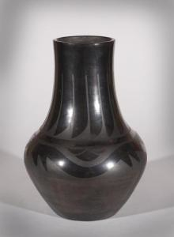
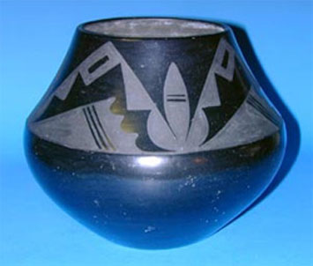
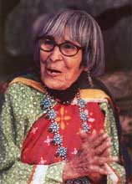
Maria Martinez
Pueblo Native American Pottery Artist

Slide 2
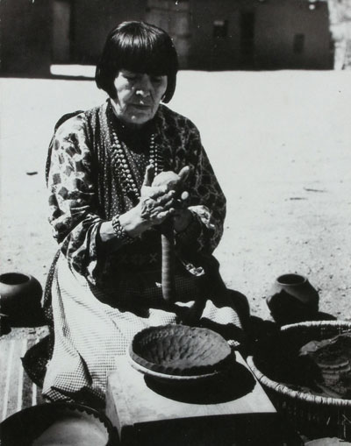
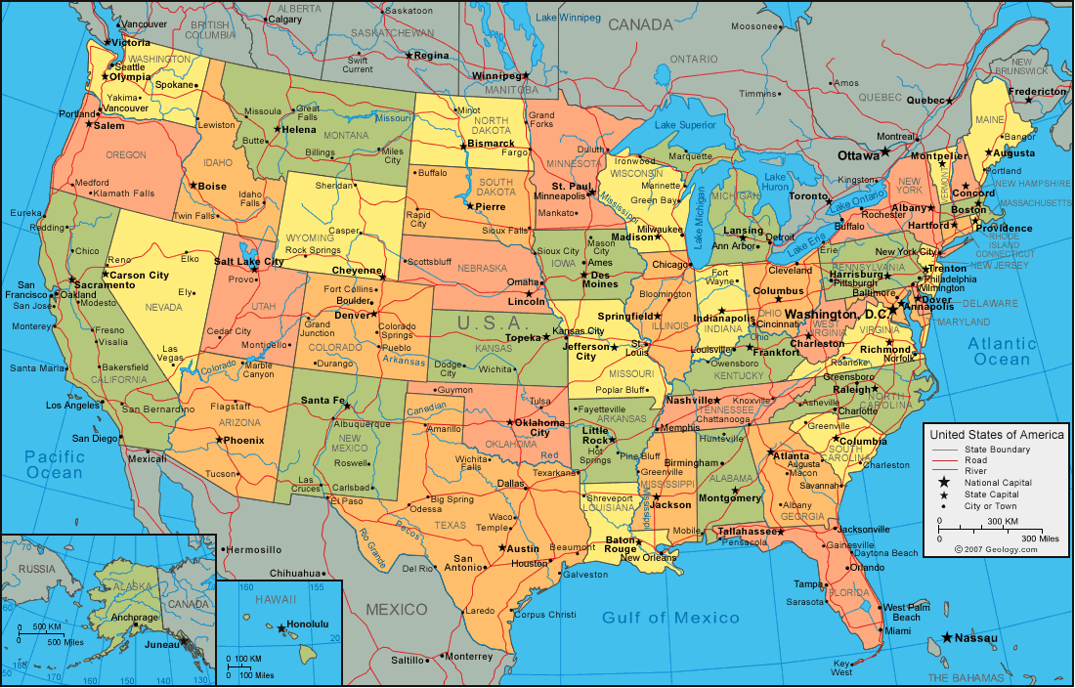
Maria Martinez: Where & When?
Lived 1884-1980
From the San Ildefonso Pueblo in New Mexico

Slide 3
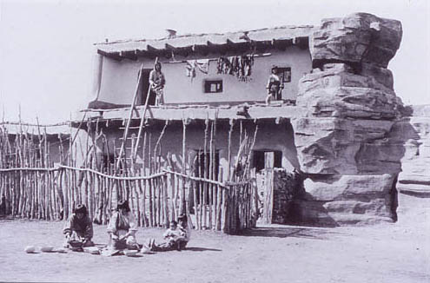
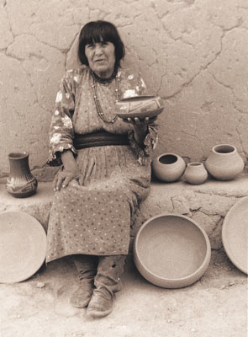
Maria Martinez: How did she learn pottery-making?
As a child, she loved watching her aunts create pottery
Pottery making was no longer popular

Slide 4
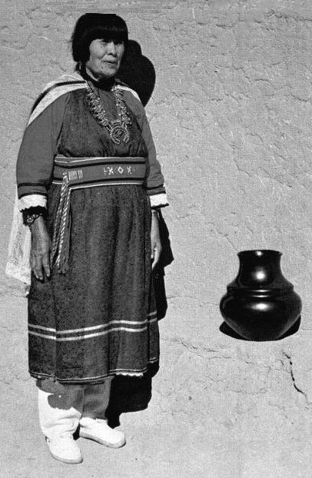
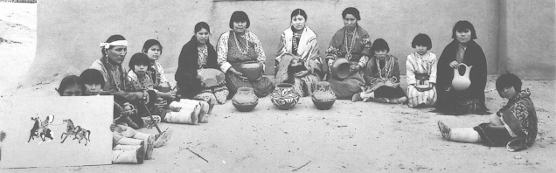
Maria Martinez: Why is she famous?
Helped to share Pueblo Native Americans’ traditions
Black pottery

Slide 5
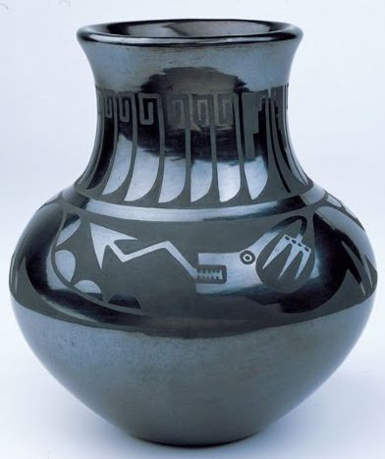
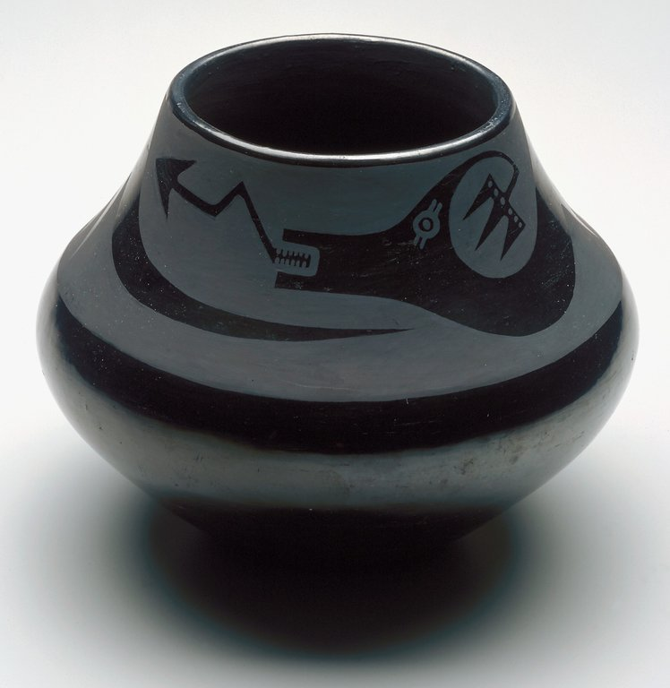
Maria Martinez
What similarities do you see? Differences?
What was the function of this pottery?

Slide 6
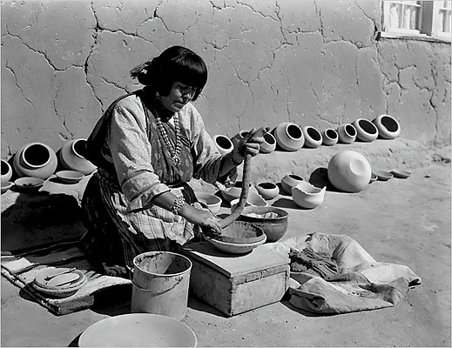
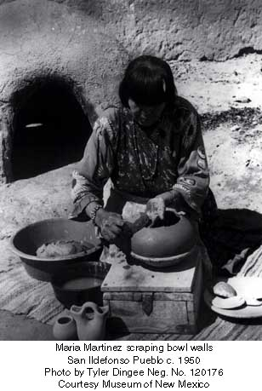
How did Maria make her pottery? First…
Find clay & sand
Mix to make clay
Roll long coils of clay
Layer coils together
Smooth out coils

Slide 7
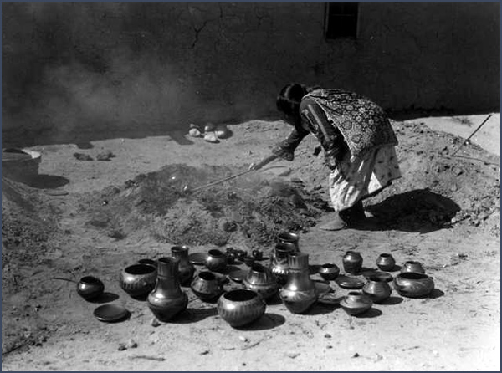
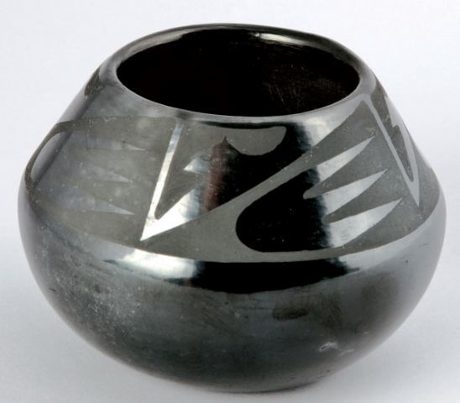
How did Maria make her pottery? Then…
Paint pottery, rub to make shiny
Heat clay in a kiln

Slide 8
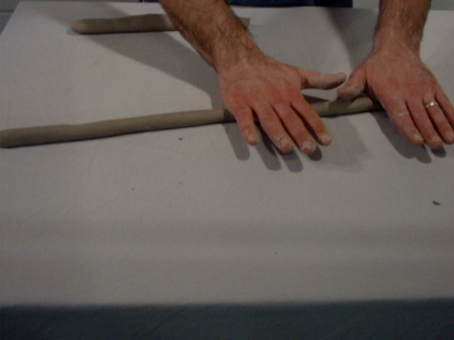
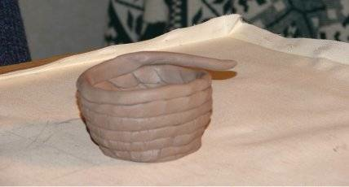
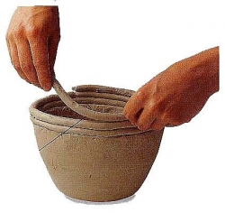
How will we make our pottery?
Roll long coils of clay
Layer them together
Smooth them out

